Slide 1
WEB DEVELOPMENT & DESIGN INTERNSHIP
THE SPARKS FOUNDATION
Kunal Kadu
GRIP JAN-2024 Batch

Slide 2
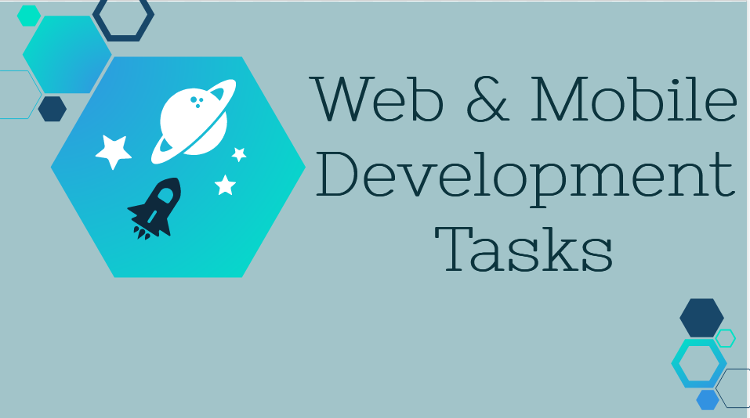

Slide 3
BASIC BANKING SYSTEM
In This Task we have created a simple Website which has - dummy data of 10 users . With the functionality of transaction of money and user is able to see transaction history.
There is no login page.We cannot create new customers.
We are able to see customers list .

Slide 4
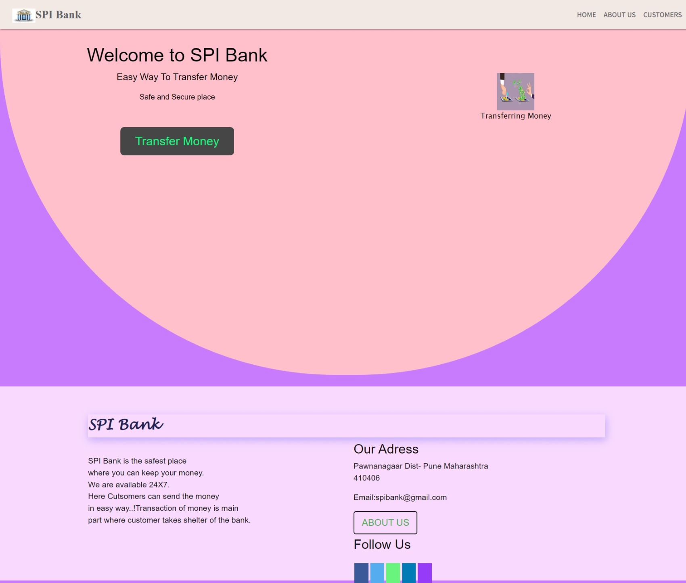
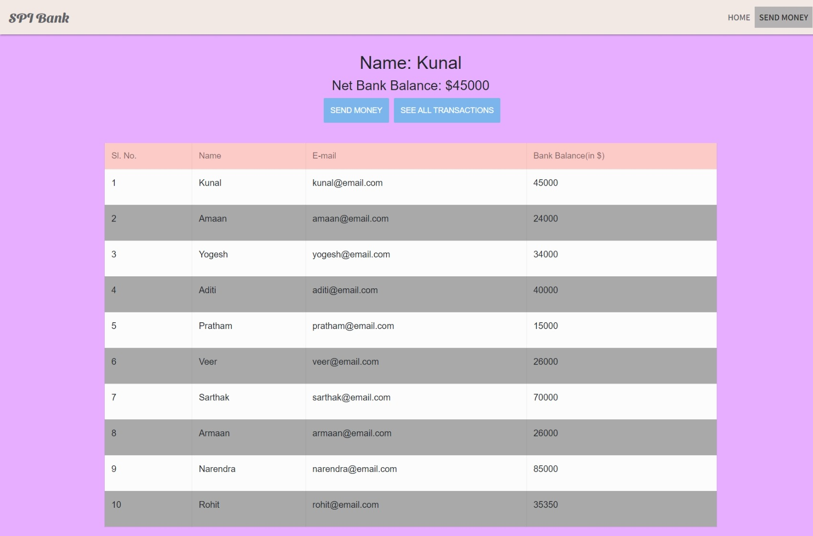
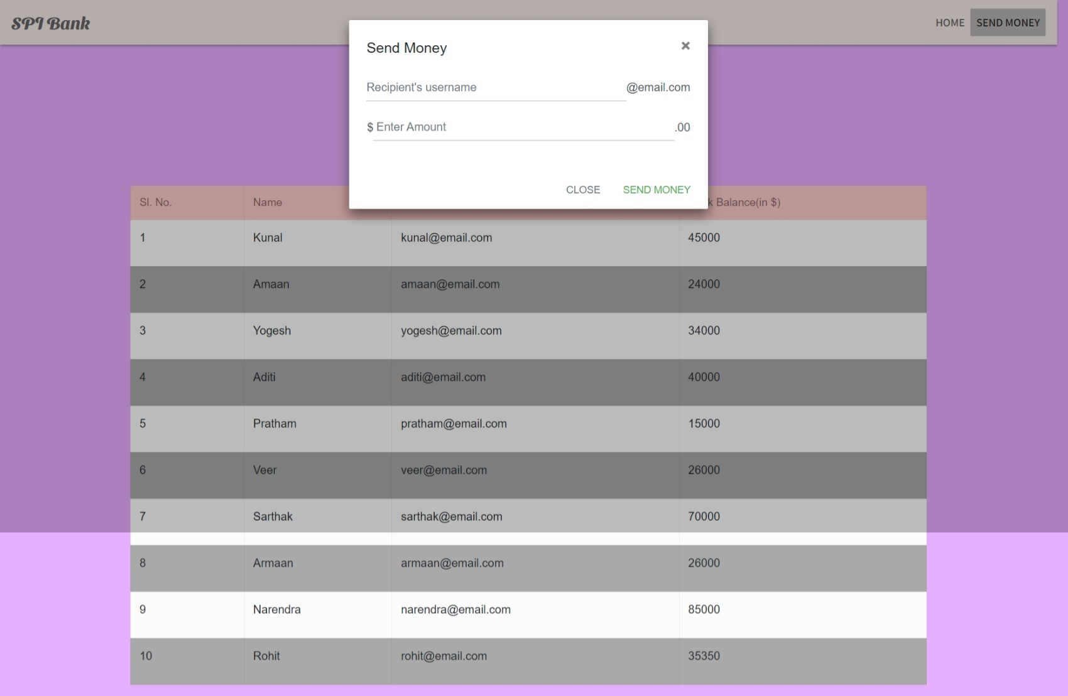

WEB PAGES

Slide 5

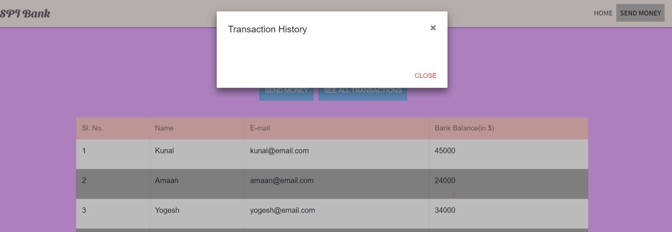
From Here we Can send Money
Here We can See Transaction History

Slide 6
About Page
Customers

